Slide 1
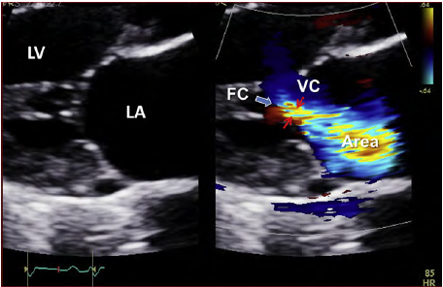
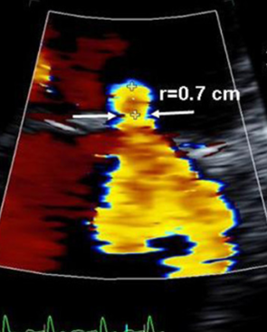
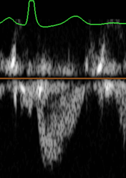
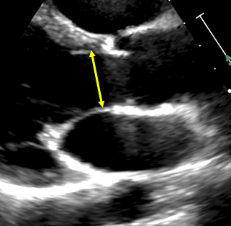
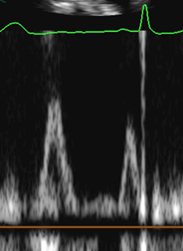
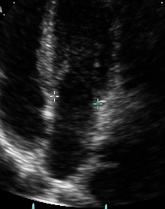
EVALUATING MITRAL REGURGITATION
 | Example | Optimization | Advantages | Limitations/Pitfalls
Vena Contracta (VC Width) |  | Zoom MV & optimize image PLAX or Apical 3 Chamber (A3C) 2D calipers only – No calculation Color Doppler sector narrow around valve DO NOT adjust your baseline/aliasing velocity Measure narrowest diameter of the proximal jet as it emerges from orifice, perpendicular to mitral leaflet closure | Independent of flow rate/driving pressure of fixed orifice May be applied in eccentric jets Easy to distinguish mild from severe MR Less dependent on technical factors | Multiple jets = underestimation Single frame Convergence zone needs to be visualized for adequate measurement Overestimation when MR is not holosystolic
Flow Convergence Method (PISA) |  | Zoom MV & optimize image Apical 4 Chamber (A4C) view Adjust Color Doppler baseline towards direction of regurgitant jet: 30 -40 cm/sec TTE: down TEE: up Obtain cine loop with adjusted baseline Measure radius (diameter length) from point of outer color aliasing to vena contracta/mitral leaflet Utilize color compare/simultaneous view to ensure accuracy Obtain MR VTI (CW) – use multiple windows to obtain best signal | Absence of proximal flow convergence usually sign of mild MR May be used in presence of valvular regurgitation or stenosis More accurate for central jets | Errors are squared! Msmt can lead to substantial errors in EROA Single frame Eccentric jets are less accurate - may impinge on hemisphere May not be accurate when multiple jets present Overestimation when MR is not holosystolic
Regurgitant Volume and Fraction (Rvol = SVMV – SVLVOT) |  | LVOT diameter measured in mid systole; PW from apical view at same site of LVOT msmt Mitral annulus diameter measured at mid diastole from A4C & A2C (average) PW at mitral annular level in diastole from A4C & A2C views to obtain VTI (average) Total LV Stroke Volume can be measured by PW technique at mitral annulus or by difference between LVED & LVES Volumes LV Volumes are best measured by 3D (If 3D not available, use 2D method of disks) | Quantitative, valid with multiple jets and eccentric jets Provides both lesion severity (EROA, RF) and volume overload (Rvol) Validated | Not valid when aortic regurgitation is present Small errors in each measurement can combine to magnify error in final results Averaging several reads when patient in arrhythmia PW (MV Stroke Volume) and LV volume method may give different results
Baseline Shift
DOWN: TTE
Aliasing Velocity

Slide 2
Chronic Mitral Regurgitation by Doppler Echocardiography
*
Does MR meet specific criteria for mild or severe?
**
Specific Criteria for Mild MR
Small, narrow central jet
VCW < 0.3 cm
PISA radius absent or < 0.3 cm at Nyquist 30-40 cm/s
Mitral A wave dominant inflow
Soft or incomplete jet by CW Doppler
Normal LV and LA size
2-3 Criteria
Specific Criteria for Severe MR
Flail leaflet
VCW > 0.7 cm
PISA radius > 1.0 cm at Nyquist 30-40 cm/s
Central large jet > 50% of LA area
Pulmonary vein systolic flow reversal
Enlarged LV with normal function
Perform quantitative methods whenever possible
>4 Criteria
EROA < 0.2 cm²
Rvol < 30 ml
RF < 30%
Grade I
EROA 0.2 – 0.29 cm²
Rvol 30-44 ml
RF 30-39%
Grade II
EROA 0.30 -0.39 cm²
Rvol 45-59 ml
RF 40-49%
Grade III
EROA > 0.4 cm²
Rvol > 60 ml
RF > 50%
Grade IV
>4 Criteria
3 specific criteria for severe MR or elliptical orifice
MILD
MR
MODERATE
MR
SEVERE
MR
* | Beware of underestimation of MR severity in eccentric, wall impinging jets; quantitation is advised
** | All values for EROA by PISA assume holosystolic MR; single grame EROA by PISA and VCW overestimate on-holosystolic MR
Mitral Inflow
E velocity > 1.2 m/sec | Supportive sign of severe MR (not specific in secondary MR, atrial fibrillation and mitral stenosis)
Dominant A-wave pattern | Excludes severe MR
Dependent on LV relaxation and filling pressures
Modified from JASE 2017 Valvular Regurgitation Guidelines

